Slide 1

NETWORK TOPOLOGY
The physical and logical arrangement of nodes and connections in a network.

Slide 2
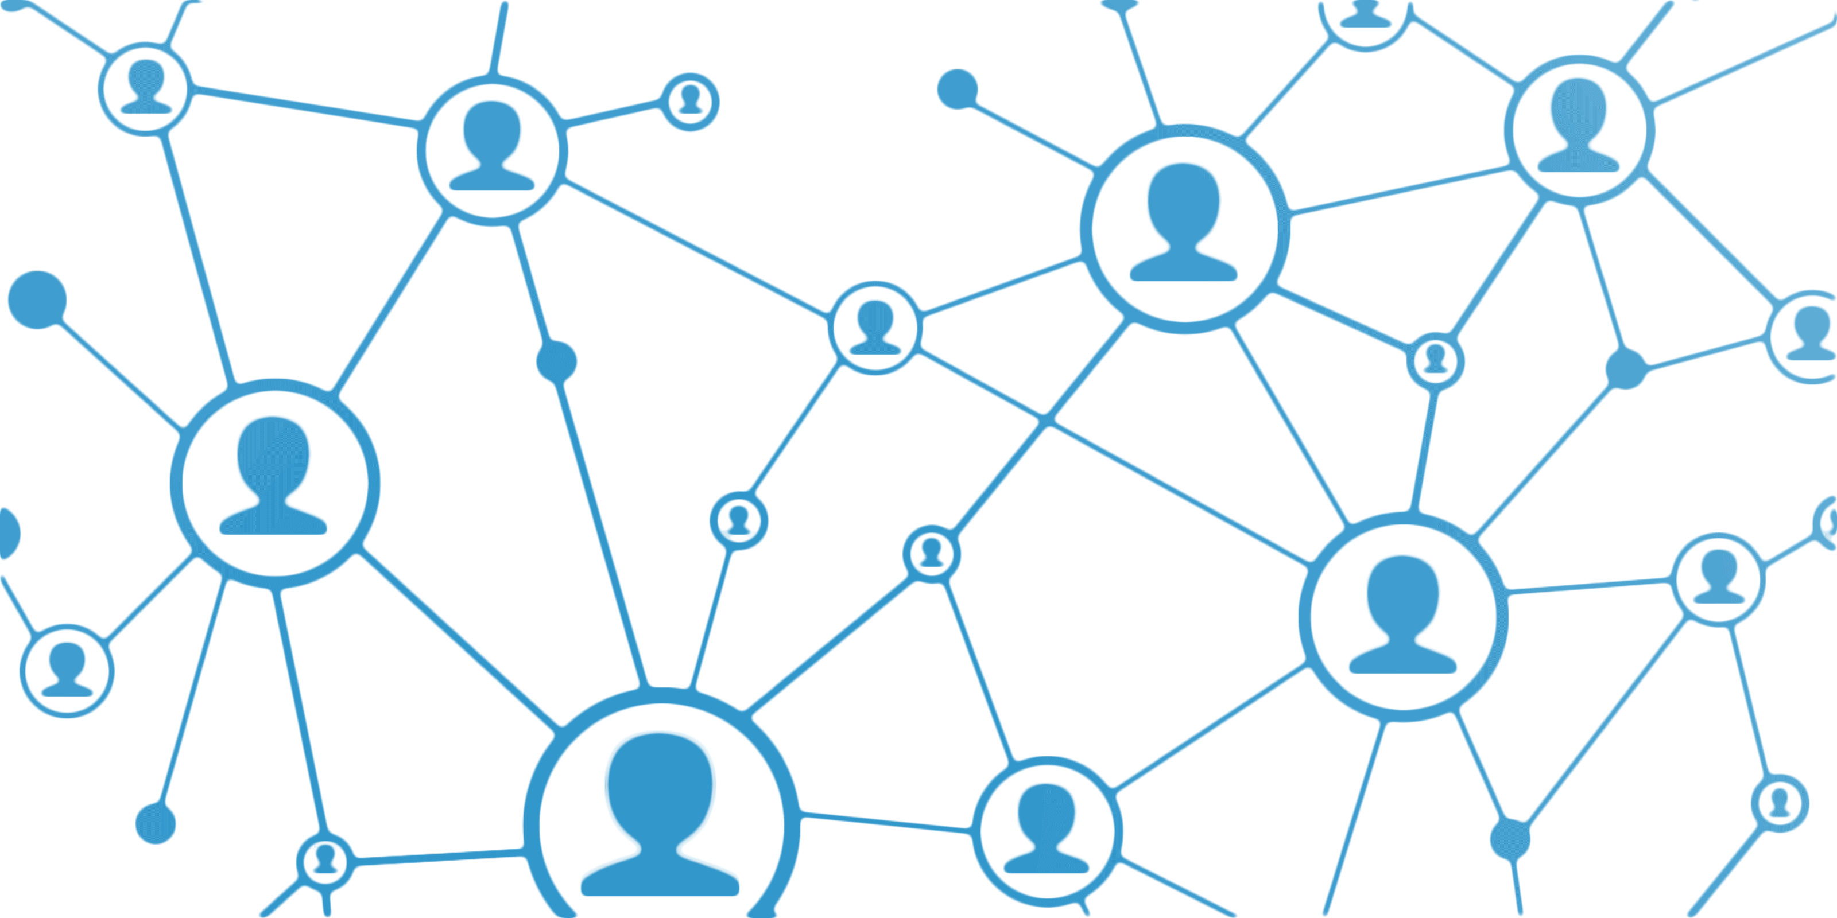
NETWORK:
A network is multiple connected computers sharing resources, exchanging files and allowing communication through various methods such as cables, phone lines, radio waves, satellites, or infrared beams
Two very common types of networks include:
Local Area Network (LAN)
Wide Area Network (WAN)
Network topology provides a visual representation of network components and their connections for performance management.

Slide 3

TOPOLOGY:
The term network topology refers to the arrangements, either physical or logical, of nodes and connections within a network. It could be said that a topology explains how a network is physically connected, and how the information in the network flows logically.
1.Physical Topology
2.Logical Topology

Slide 4
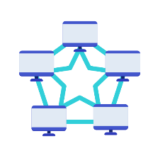
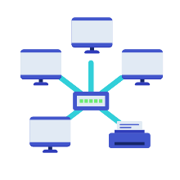
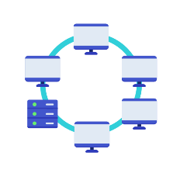
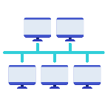
TYPES OF TOPOLOGY:
BUS TOPOLOGY
STAR TOPOLOGY
Every node is connected in series along a single cable.
a central device connects to all other nodes through a central hub.
TYPES OF
TOPOLOGY
MESH TOPOLOGY
RING TOPOLOGY
All devices are connected to every other device in the network.
the nodes are connected in a closed-loop configuration

Slide 5
Importance of Topology :
COST EFFECTIVENESS 01
Cost-effectiveness is a major benefit of network topology due to the ability to identify and eliminate inefficient components.
EASIER TO UNDERSTAND NETWORK CONCEPT 02
Topology is essential in understanding networking and network design theory.
TOPOLOGY DIAGRAMS ENABLE GOOD COMMUNICATION 03
Topological diagrams are helpful roadmaps for designing effective systems and improving communication.
EASE OF TRAINING 04
Use topologies as a guide for on boarding and connecting everything, and seek expert help if needed.

Slide 6
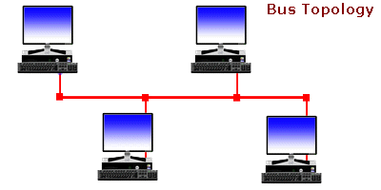
BUS TOPOLOGY:
Every node is connected in series along a single cable. Most 802.3 (ethernet) and 802.4 standard networks employ the bus topology.
Among bus topologies, CSMA is the most used access technique (Carrier Sense Multiple Access).
tap
dropline
Cable end
Cable end
dropline
tap

Slide 7
ADVANTAGE OF BUS TOPOLOGY:
01
02
03
04
LOW COST CABLE
MODERATE DATA SPEEDS
FAMILIER TECHNOLOGY
LIMITED FAILURE
Low installation cost in bus topology due to direct connection of nodes to cable without passing through a hub.
Coaxial or twisted pair cables are mainly used in bus-based networks that support upto 10 Mbps.
Bus topology is a popular and easily manageable technology.
A failure in one node will not have any effect on other nodes.

Slide 8
DISADVANTAGE OF BUS TOPOLOGY:
RECONFIGURAITON DIFFICULT 04
EXTENSIVE CABALING 01
Adding new devices to the network would slow down the network.
A bus topology is simpler, but still requires a lot of cabling.
DIFICULT TROUBLE SHOOTING 02
DISADVANTAGE
Specialized equipment needed to detect cable faults, which can disrupt communication for all nodes.
ATTENUATION 05
Attenuation causes communication problems, so repeaters regenerate the signal
SIGNAL INTERFERENCE 03
Simultaneous message transmission results in signal collision.

Slide 9
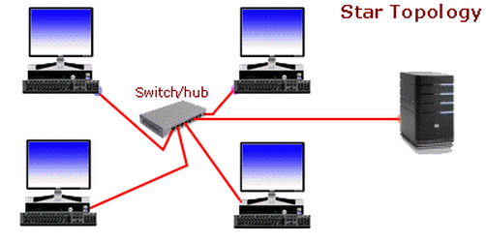
Star topology:
A central device connects to all other nodes through a central hub.
The central computer is known as a server, and the peripheral devices attached to the server are known as clients. Hubs or Switches are mainly used as connection devices in a physical star topology.

Slide 10
ADVANTAGE OF STAR TOPOLOGY:
01
02
03
04
Efficient troubleshooting
Network control
Limited failure
Familiar technology
Easily expandable
Cost effective
High data speeds

Slide 11
DISADVANTAGE OF STAR TOPOLOGY:
A Central point of failure
If hub/switch fails, nodes can't communicate.
DISADVANTAGE
Cable
Cable routing can be challenging with extensive routing

Slide 12
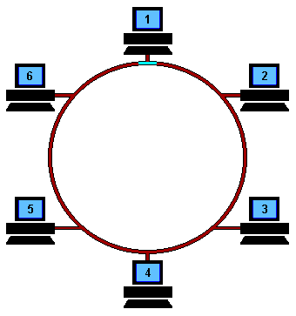
Ring topology:
The nodes are connected in a closed-loop configuration .
The most common access method of the ring topology is token passing.

Slide 13
ADVANTAGE OF RING TOPOLOGY:
Network Management
Remove faulty devices without network downtime..
Product availability
Various tools for network operation and monitoring exist
ADVANTAGE
Cost
Low installation cost due to inexpensive and readily available twisted pair cabling.
Reliable
More reliable network, not dependent on single host computer.

Slide 14
DISADVANTAGE OF RING TOPOLOGY:
1
3
Difficult
troubleshooting
Reconfiguration difficult
Specialized equipment needed to detect cable faults which can disrupt communication for all nodes.EP 02
Adding new devices to the network would slow down the network.
2
4
Failure
Delay
One station's breakdown = network failure.
More nodes = more delay.

Slide 15
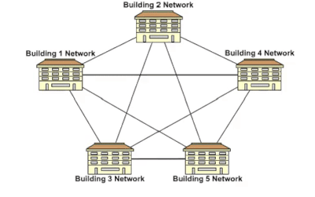
MESH TOPOLOGY:
All devices are connected to every other device in the network.
Mesh topology can be formed by using the formula :
Number of cables = (n*(n-1))/2;

Slide 16
ADVANTAGE OF MESH TOPOLOGY:
Reliable
Mesh networks are highly reliable because link breakdowns do not impact communication between connected devices.
Fast Communication
Communication is very fast between the nodes.
ADVANTAGE
Easier Reconfiguration
Adding new devices won't disrupt other device communication.

Slide 17
DISADVANTAGE OF MESH TOPOLOGY:
1
3
COST
EFFICENCY
Mesh topology has many connected devices and transmission media compared to other topologies.EP 02
Redundant connections are high in this topology, reducing network efficiency.
2
MANAGEMENT
Delay
Mesh networks are challenging to maintain and monitor, and link failures may go unnoticed without careful observation.

Slide 18
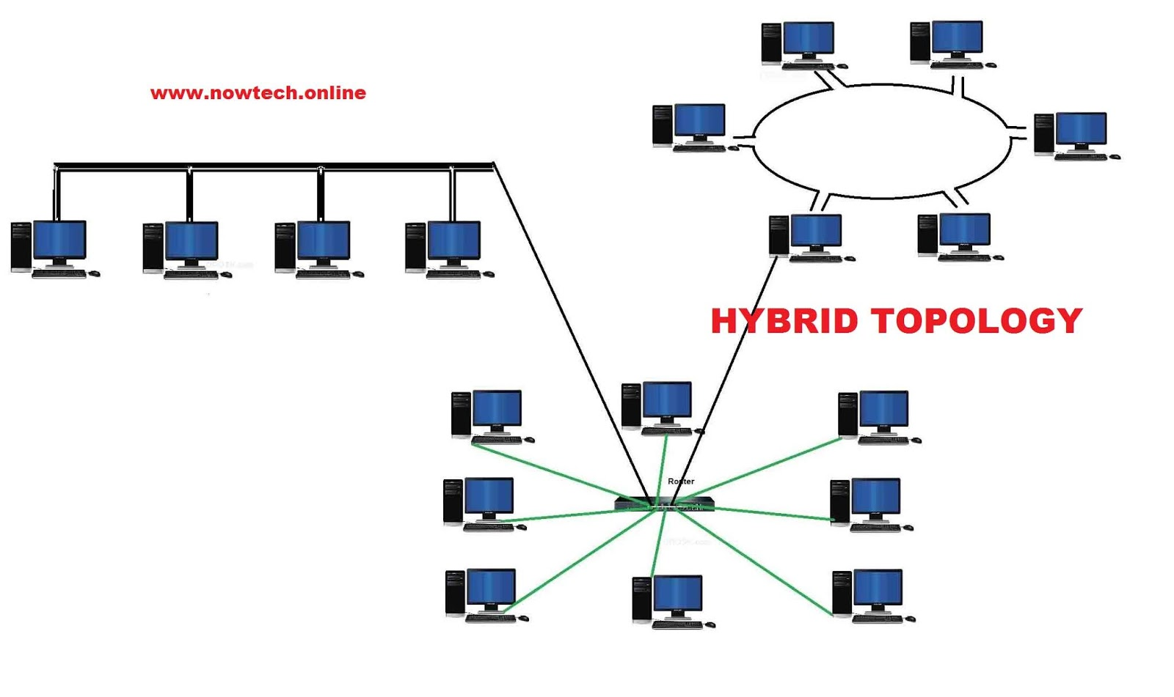
HYBRID TOPOLOGY:
A hybrid topology is a type of network topology that uses two or more differing network topologies. These topologies can include a mix of bus topology, mesh topology, ring topology, star topology, and tree topology.

Slide 19
ADVANTAGE OF HYBRID TOPOLOGY:
Reliable
A network fault will not affect other parts of the network.
Scalable
Network size can expand by adding new devices without affecting existing functionality.
ADVANTAGE
Flexible
This topology is flexible and customizable to an organization's needs.
Effective
Hybrid topology maximizes network strength and minimizes weaknesses.

Slide 20
DISADVANTAGE OF HYBRID TOPOLOGY:
1
3
Costly Hub
Complex design
Hybrid topology's Hubs are costly as they differ from regular Hubs in other topologies.
The design of a hybrid network is very complex..
2
Costly infrastructure
Delay
High infrastructure costs for hybrid networks due to cabling and network devices.

Slide 21
NETWORK TOPOLOGY AND NETWORK PERFORMANCE:
Network topology affects network performance.
CONCLUSION :
It is also important to consider the security and performance implications of the network topology when designing a network. Security and performance measures should be implemented to ensure the network is secure and performs optimally.

